Slide 1

Hydrogen/Ammonia Lit Review Part 1

Slide 2
Reviewing papers sent over
Path to Hydrogen Competitiveness-Hydrogen Council
Ammonia as a Renewable Energy Transportation-Giddey
Carbon Free Hydrogen-NEOM deck from AP
Ammonia to Green Hydrogen Project- Siemens feasibility study
LCA of Ammonia Production- Singh
Feasibility study of implementing Ammonia Economy-Bartels
Feasibility Study on Supply Chain of CO2-Free Ammonia-Kawakami
Ammonfuel industrial view report-Laval
Ammonia to Power LCOE-Cesaro
Green vs Grey Ammonia Levelized Cost (LCOA) -Dii Desert Energy

Slide 3
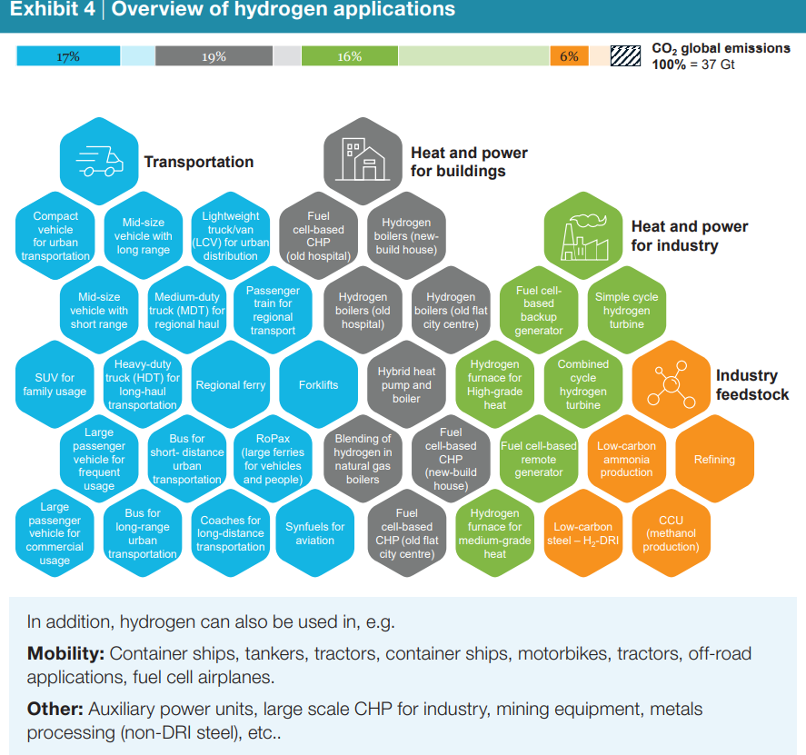
1. Path to Hydrogen Competitiveness-Hydrogen Council
Report looks at cost competitiveness for 40 hydrogen technologies used in 35 applications
Mentions shipping liquid hydrogen-ammonia is seen as better option
Key findings:
Scaling up manufacturing is main cost reductions-production and distribution of hydrogen and the manufacturing of system components
Goes into good detailed sections on various different technologies
See next slide for which sectors to target

Slide 4
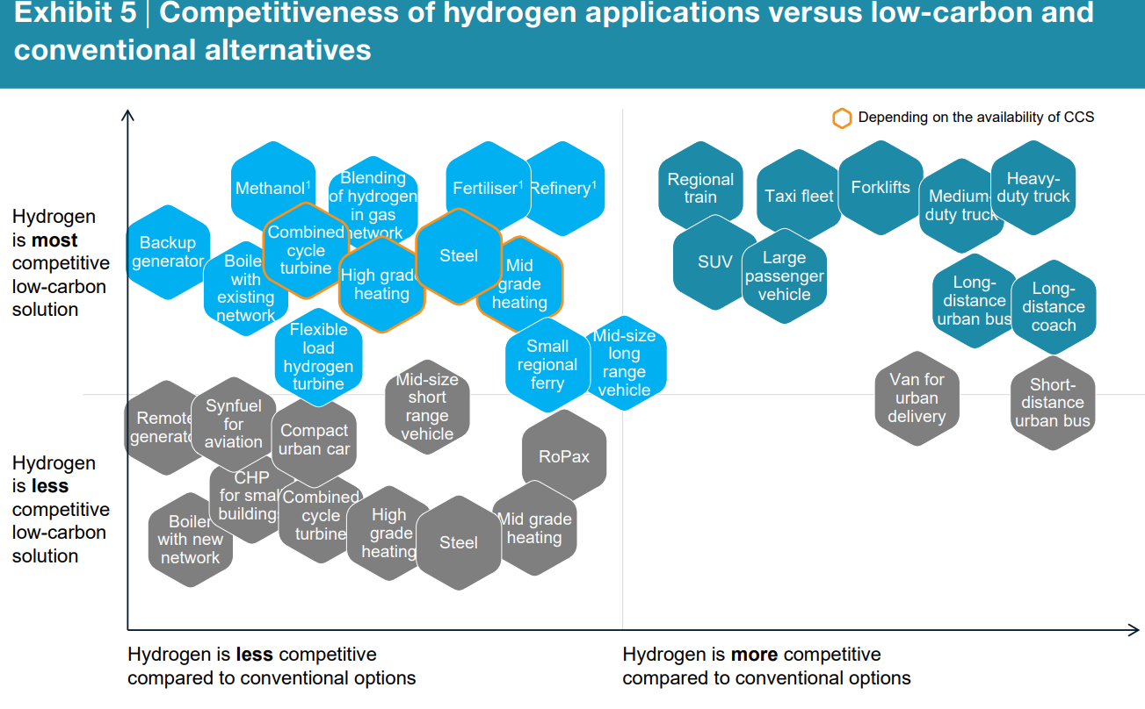
Heavy duty mobility is priority target and aligns with NEOM goals
*RoPax-large ferries for vehicles and people
*CHP-combined heat and power

Slide 5
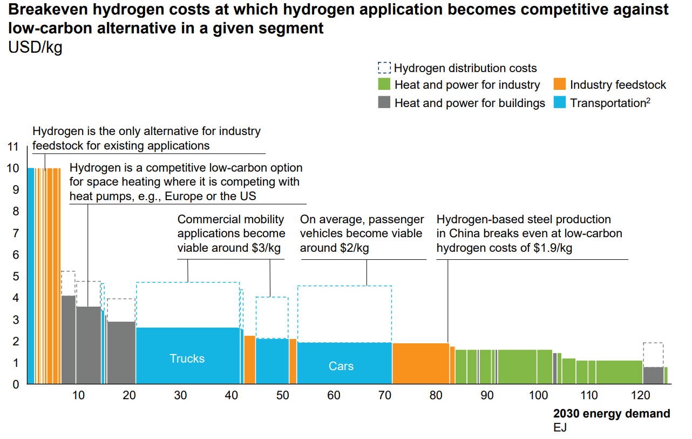
Price Ranges for breaking into different market sectors with mobility around $2-3/kg

Slide 6
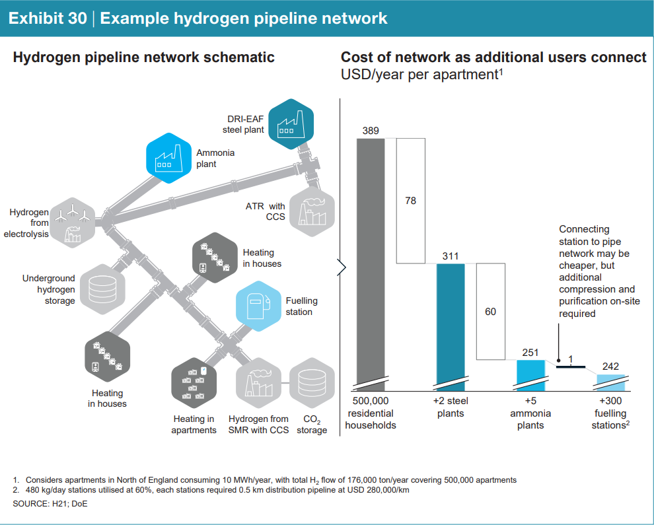
Cascading effects for H₂ deployment-system integration perspective needed
*DRI-direct reduced iron
*ATR-Autothermal reforming

Slide 7
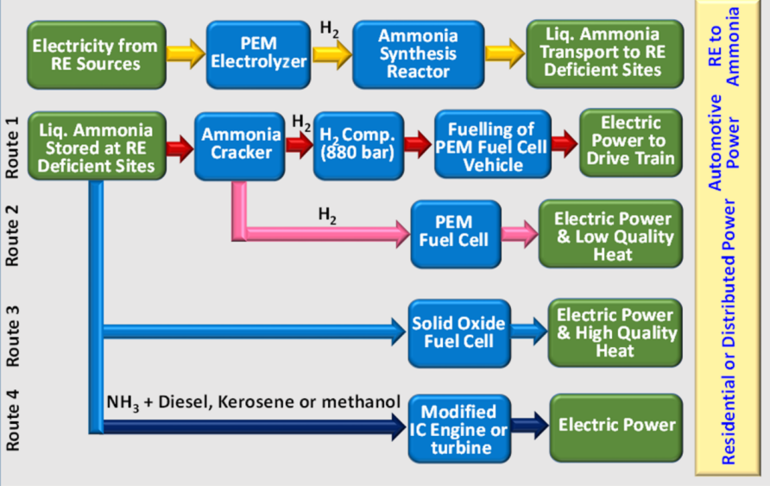
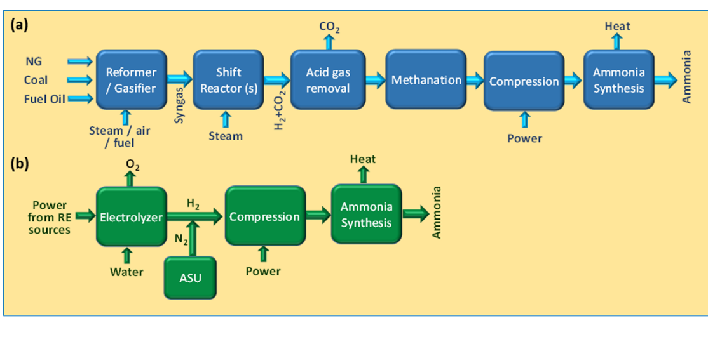
2. Ammonia as a Renewable Energy Transportation
Lit Review on ammonia production/use and estimates round-trip efficiencies
See next slide for which sectors to target
Provides nice introduction to ammonia production space

Slide 8
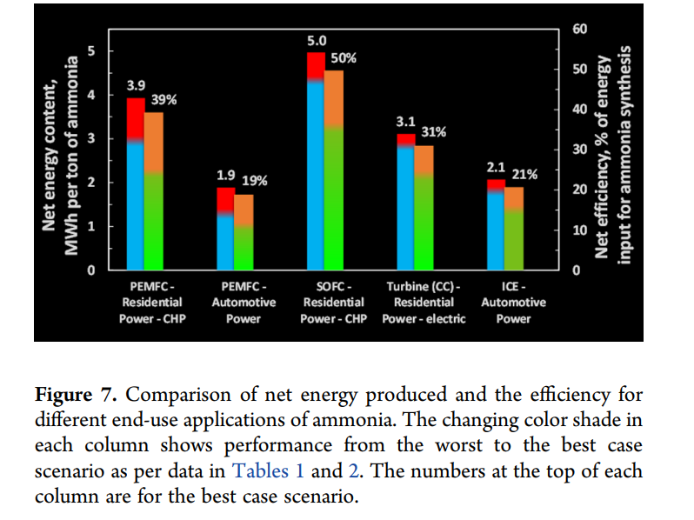
(large ferries for vehicles and people)
*PEMFC-polymer electrolyte membrane fuel cell
*SOFC-solid oxide fuel cell
*comparison of fuel cells

Slide 9
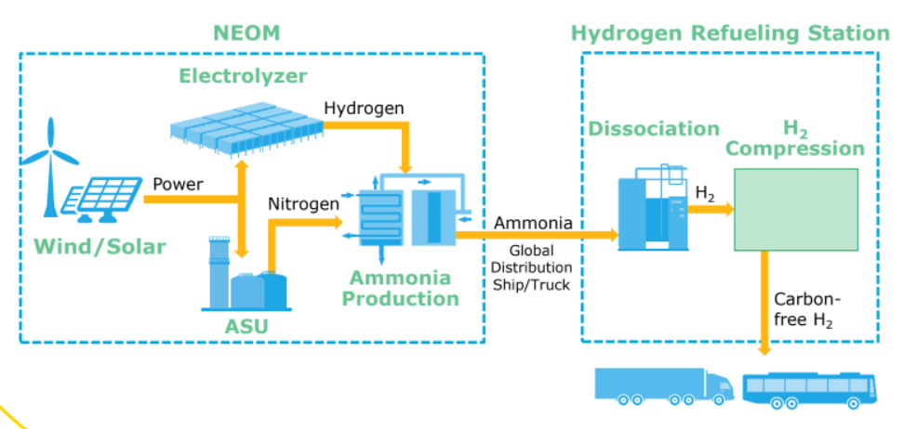
3. Carbon Free H₂-NEOM deck from AP
Announces plans for NEOM H₂ and NH₃ plant development
Key Details
Expected to remove ~700,000 cars worth of CO₂-curious to see how number was calculated
Plant will be targeting the transportation sector (specifically busses and trucks)

Slide 10
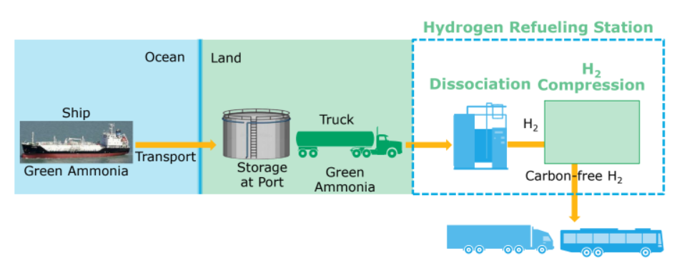
3. Carbon Free H₂-NEOM deck from AP
Involves three entities-NEOM, ACWA power, and Air Products
Equal ownership at production
AP controls distribution to end customers
Opts for trucking from NH₃ from port to refueling station where it will be cracked-decentralized approach

Slide 11
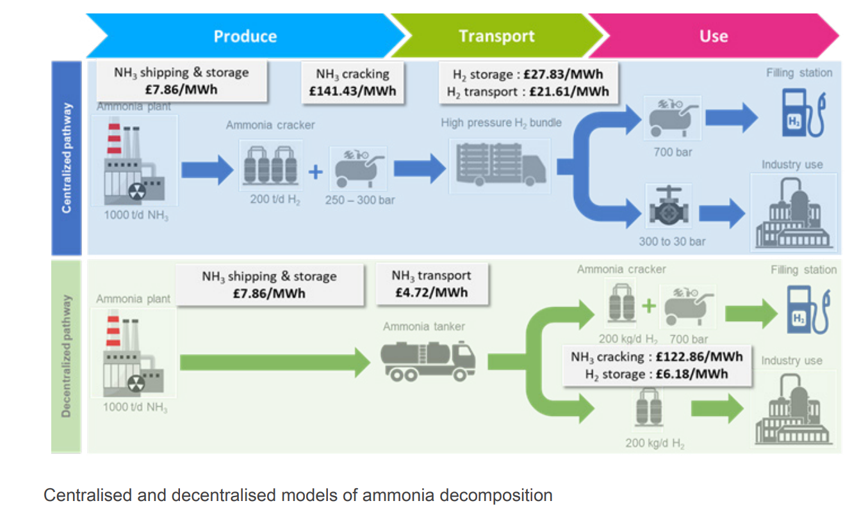
4. Ammonia to Green Hydrogen Project-Feasiblity study w/ Siemens
Report looks at cracking technologies and possible pathways for widespread ammonia distribution
Compares centralized vs decentralized cracking options and exploration of catalysts for cracking.
Key findings:
Decentralized cracking often more economically attractive than centralized model
Centralized becomes more attractive with lower distribution distances (e.g. ports w/ supply and demand colocated)
More cost effective to import green hydrogen in form of ammonia and crack in UK than produce green hydrogen in the UK

Slide 12
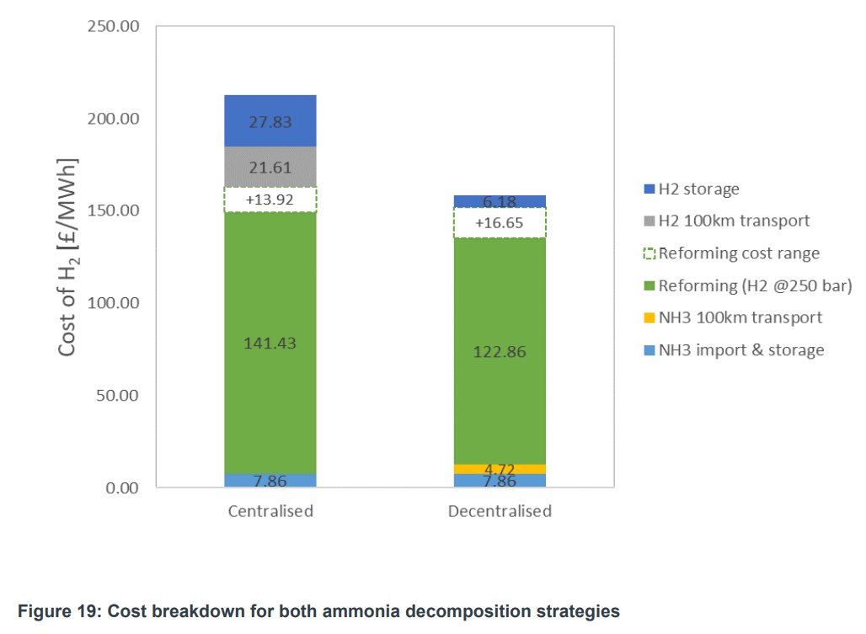
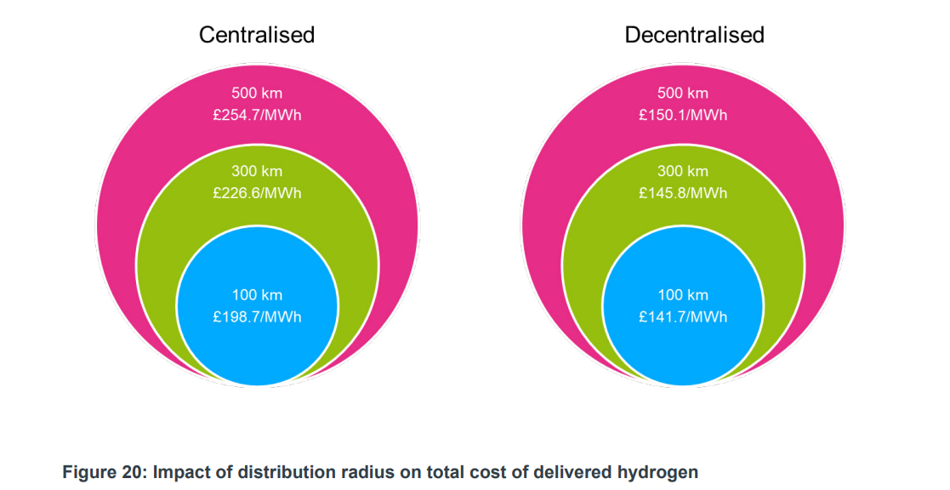
4. Ammonia to Green Hydrogen Project-Feasiblity study w/ Siemens
Report outlines break down of the two different cracking tech
Also looks at impact of distance on final H₂ cost

Slide 13
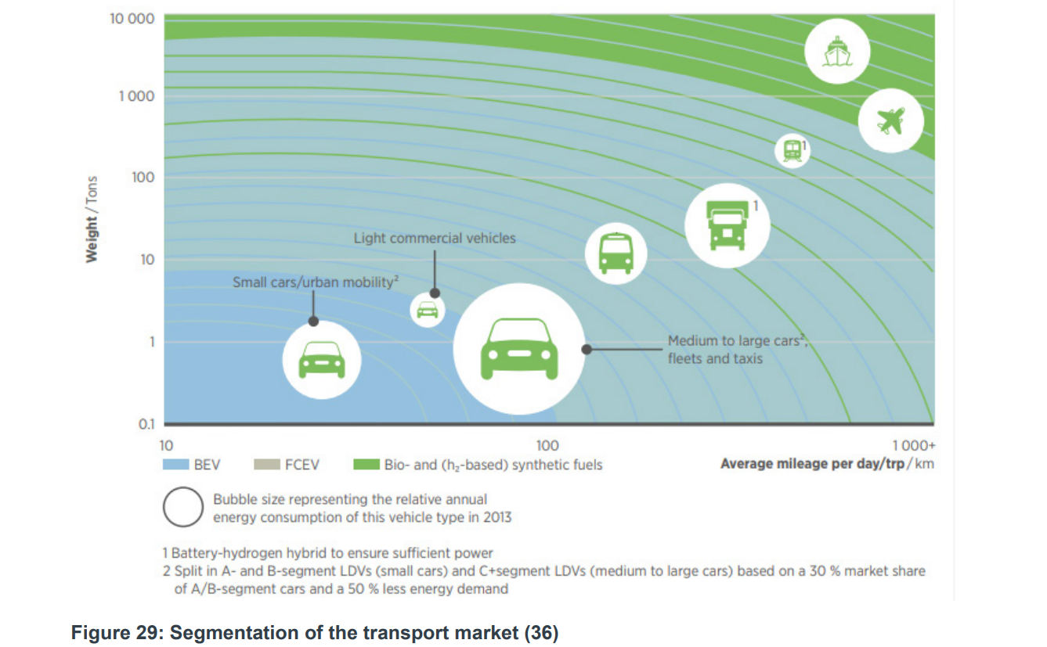
4. Ammonia to Green Hydrogen Project-Feasiblity study w/ Siemens
Transportation market can be first block to build on then move to electricity generation and eventually heating
Even carbon intensive hydrogen can play a short term role in establishing market for hydrogen
Thereby improving the case for subsequent investment in low/zero-carbon hydrogen production

Slide 14
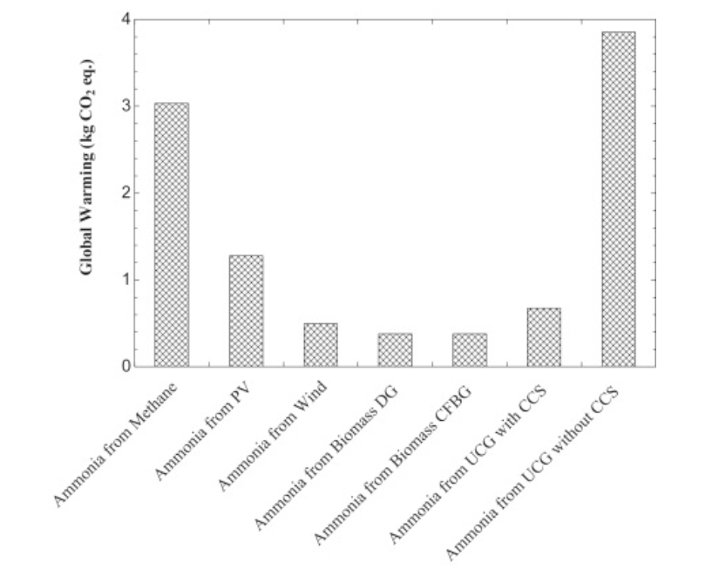
5. LCA of Ammonia Production pathways
Five methods and seven ammonia pathways compared in LCA (fossil fuels, biomass gasification, and electrolysis w/ RE)
Key findings:
Biomass gasification least environmentally harmful w/ GWP ~0.378 kg per kg NH₃ produced
Only one incomplete part of the entire value chain
Solar was often the highest in non GWP categories due to mineral extraction/manufacturing requirements
See next slides for complete comparison across tech/categories

Slide 15
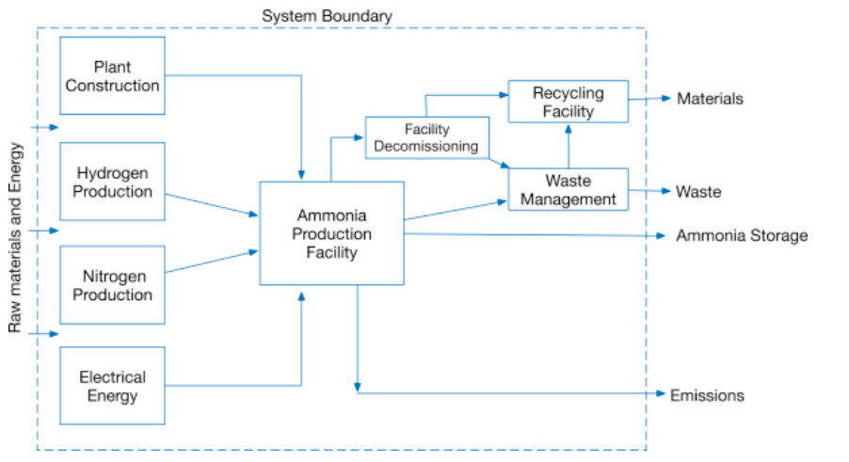
5. LCA boundaries analyzed only production

Slide 16
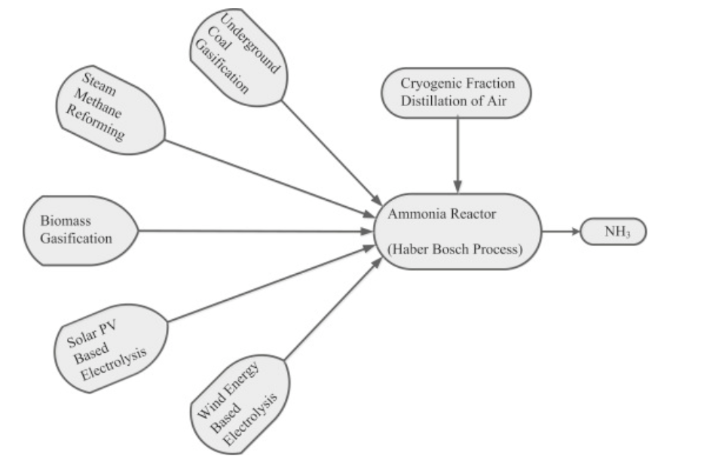
5. 5 routes analyzed in LCA (7 total production types includes coal gasification w/ or w/out CCS and same with biomass

Slide 17
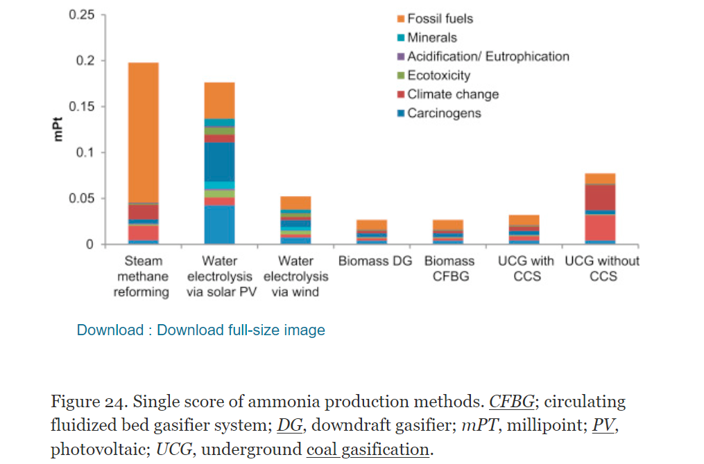
5. PV 2nd worst when analyzing across other non GWP cateogires

Slide 18
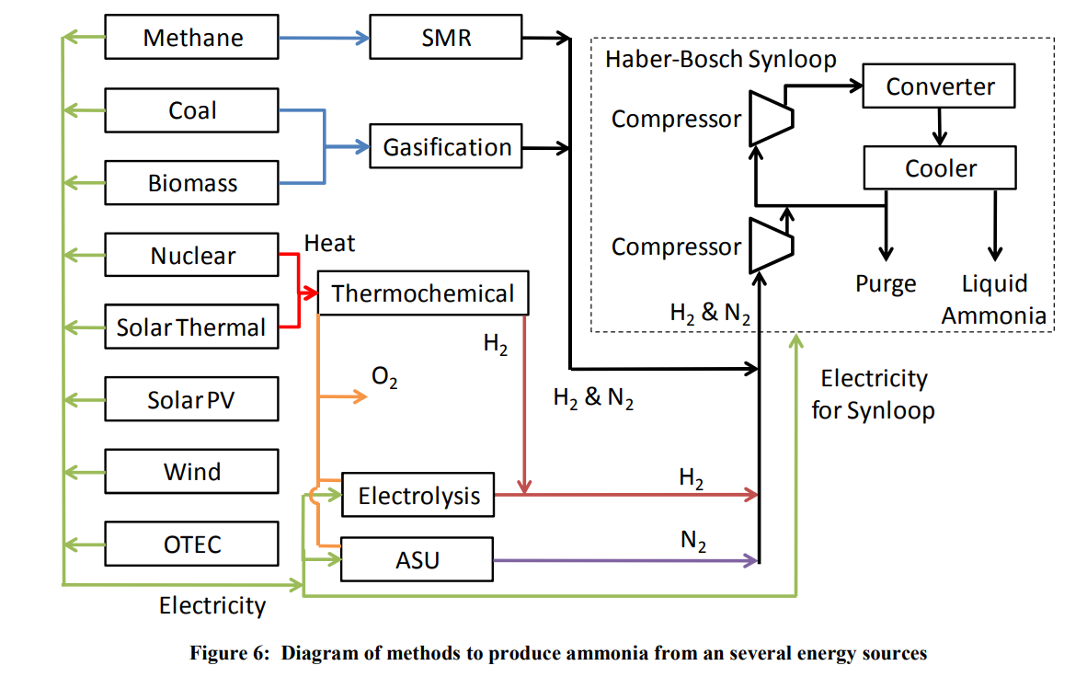
6. Feasibility study of implementing Ammonia Economy
Feasibility study of an Ammonia Economy, NH₃ treated as alternative fuel and energy storage mechanism.
Creates economic model to calculate the cost of ammonia from various energy sources.
Looks at components that could make up ammonia and hydrogen economy
From 2008 so numbers quite outdated however efficiencies used/process diagrams can be helpful
In all cases with either storage or transport costs included, ammonia is more economical than hydrogen.

Slide 19
7. Feasibility study on Supply Chain of CO₂

Slide 20
8. Ammonfuel industrial view report

Slide 21
9. Ammonia to Power LCOE Study

Slide 22
10. Green vs Grey LCOA

